Slide 1
Capstone Project Churn Modelling at Mobicom
By-Digant Vaibhav Gupta
9745032462

Slide 2
Introduction
Management at Mobicom are worried about the high churn rate and declining ARPU which the industry is currently facing
According to the Churn market survey report 40% of the customers are planning to switch provider in the next 12 months.
Major reason for switching are :
Cost and billing
Network service and quality
Recommendation of friends and family

Slide 3
Proactive Retention Strategies
The company wants to devise targeted strategies and marketing initiatives in order to prevent the churn like:-
Driving increase in usage
Moving customers to optimal rate plans
Bundling strategies for family

Slide 4
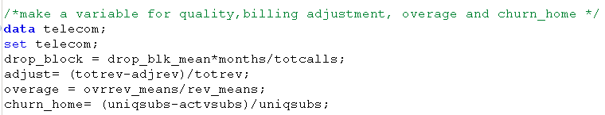
Solution Design
Data Preparation
Removing vaiables, age1, age2, mtrcycles, csa, dwlltype, dwllsize, div_type, proptype, car_buy, cartype, mailordr, mailresp, occu1, solflag and wrkwoman as they have huge number of nulls.
Clean data has 47451 observations
Including new variables which are crucial for the industry to determine churn

Slide 5
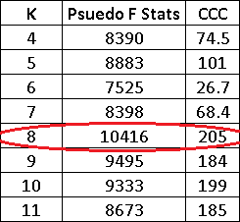
Clustering
Clustering is performed based on the following:
Churn
Overage
Drop_block
Adjust
Churn_home
Total recurring monthly charge

Slide 6
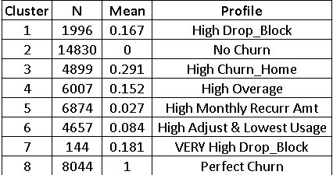
Cluster Size ,Churn Proportion and Profile

Slide 7
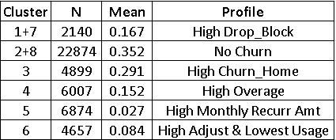
Combining clusters

Slide 8
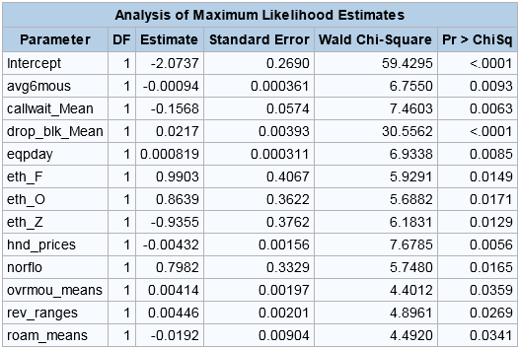
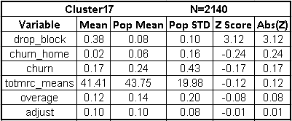
Cluster 17 – High number of Dropped and Blocked calls

Slide 9
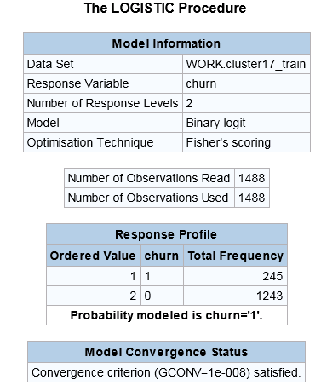
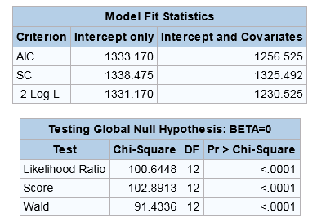
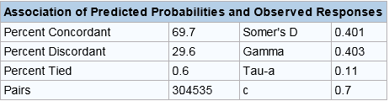

C17_Train Goodness of Fit
Accuracy
= (1228+9)/(1228+9+15+236)
= 83%
 | Predicted Non-Events (0) | Predicted Events (1)
Actual Non-Events (0) | True Negatives (1228) | False Positives (15)
Actual Events (1) | False Negatives (236) | True Positives (9)

Slide 10
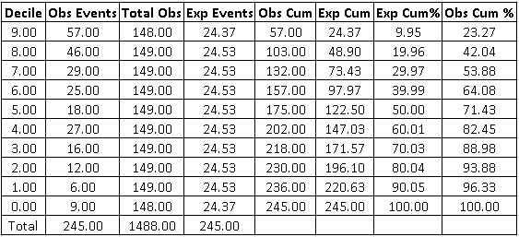

Slide 11
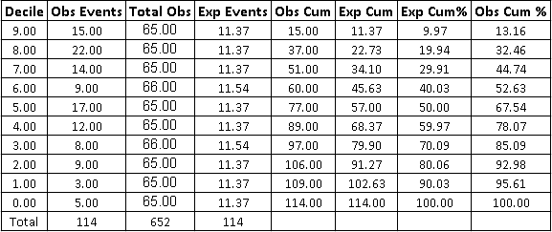

Slide 12
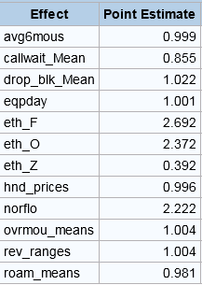
Factors affecting churn for Cluster 17
Customer belonging to this segment will be the one who are experiencing maximum number of dropped and blocked calls.
For this segment following are the top 5 important factors that drive churn
Customers of French or Asian ethnicity are 2.5 times more likely to switch operator as compared to an American
Customers from North Florida are 2.2 times more likely to switch the operator as compared to the customers from New York City.
Customers of African-American ethnicity have 60% less odds of switching as compared to that of Americans.
If mean of waiting calls of a customer increases by 1 then there is 15% reduction in the odds of switching operator.
If mean of dropped and blocked calls of a customer increases by 1 then there is 2.2% increase in the odds of switching operator.

Slide 13
Retention strategy and prioritization of high churn possibility customers
Customers of French and Asian ethnicity must be targeted and should be provided with optimal solution of dropped and blocked calls
Customers belonging to North Florida must be targeted
Network strength must be analyzed in the area to gather more information related to geographical factors influencing churn

Slide 14
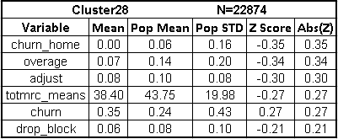
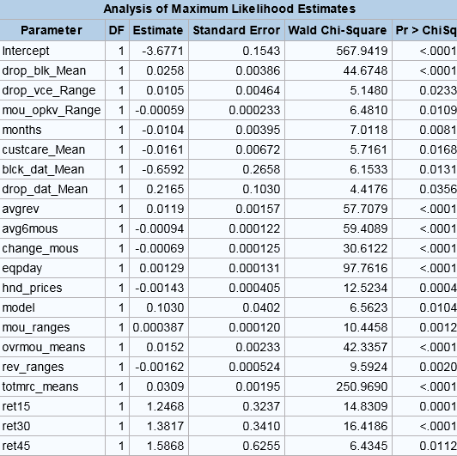
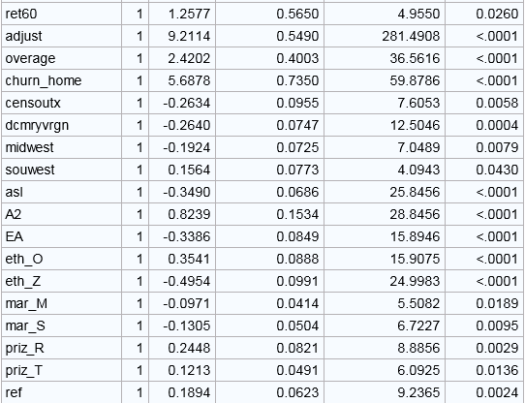
Cluster 28 – All crucial parameters low

Slide 15
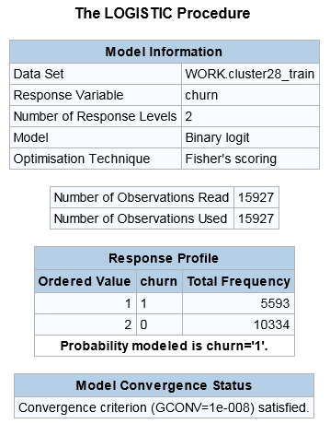
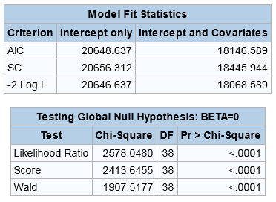
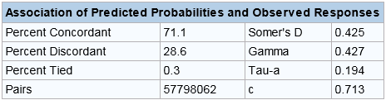
C28_Train Goodness of Fit
Accuracy
= (9466+2056)/(9466+2056+868+3537)
= 72.34%
 | Predicted Non-Events (0) | Predicted Events (1)
Actual Non-Events (0) | True Negatives (9466) | False Positives (868)
Actual Events (1) | False Negatives (3537) | True Positives (2056)

Slide 16
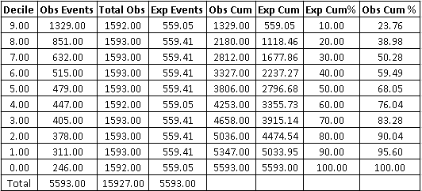

Slide 17
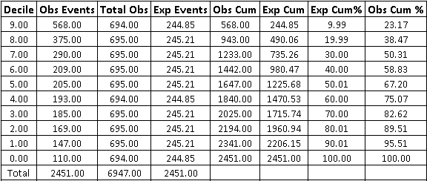

Slide 18
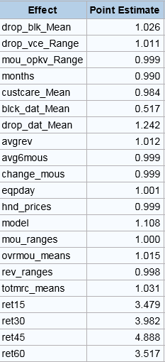
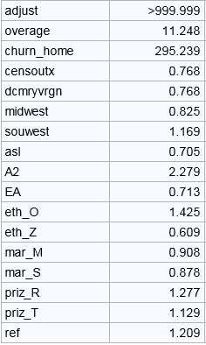
Factors affecting churn for Cluster 28 (Low crucial parameters)
Customers of this segment have all the crucial parameter lower than the average of population
0.1 increase in adjust will lead to (999^0.1=1.99) 99% increase in odds of churn
0.1 increase in churn @ home will lead to (295^0.1=1.76) 76% increase in odds of churn
0.1 increase in overage will lead to (11.2^0.1=1.27) 27% increase in odds of churn
If retention call has been made to the customer in last 0 to 60 days as compared to the call being made 60 or greater days ago then the there is 3 times increase in the odds of churn
if the credit rating of the customer is A2 then there are 2.2 times the odds of churn as compared to AA

Slide 19
Retention strategy and prioritization of high churn possibility customers
Customers of this segment will be highly likely to switch if they are having one or many conditions as mentioned below and hence must be prioritized:-
If they are facing high dropped and blocked calls
Many house members have already switched to the competition operator
Proportion of overage is high in the bill
Proportion of adjusted amount is high in the bill
If they are receiving retention calls
Credit rating is A2
They use a refurbished handset instead of a new one
They are residents of towns and rural areas

Slide 20
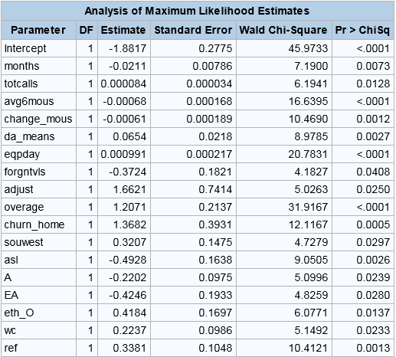
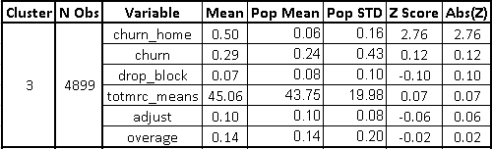
Cluster 3– Highest proportion of family members who have switched operator

Slide 21
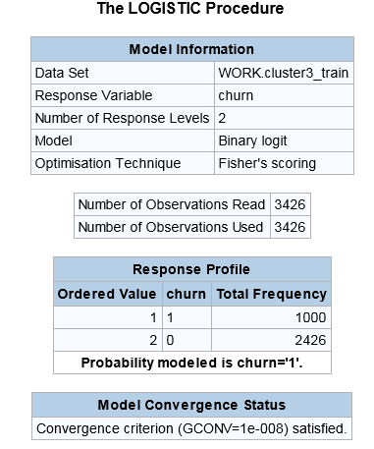
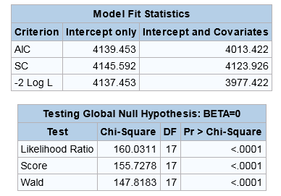
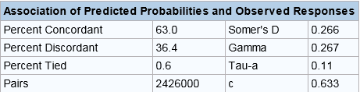

C3_Train Goodness of Fit
Accuracy
= (47+2368)/(47+2368+953+58)
= 70%
 | Predicted Non-Events (0) | Predicted Events (1)
Actual Non-Events (0) | True Negatives (2368) | False Positives (58)
Actual Events (1) | False Negatives (953) | True Positives (47)

Slide 22
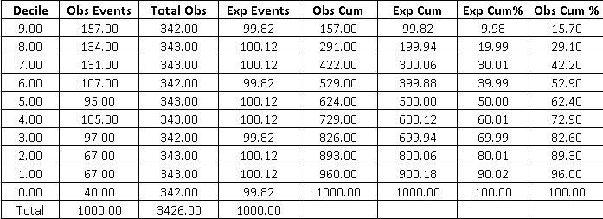

Slide 23
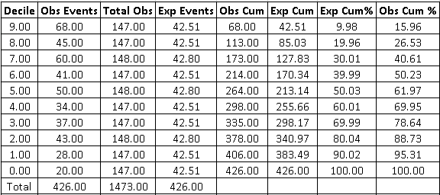

Slide 24
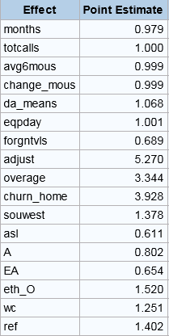
Factors affecting churn for Cluster3
Customers of this segment have high proportion of their family members who have switched to competition operator.
Top 5 factors affecting churn are:-
0.1 increase in adjust leads to an increase of (5^0.1=1.17) 17% in the odds of switching. ((totrev-adjrev)/totrev)
0.1 increase in churn_home leads to an increase of (3.92^0.14) 14% in the odds of switching. ( (uniqsubs-actvsubs)/uniqsubs)
0.1 increase in overage leads to an increase of (3.34^0.1=1.13) 13% in odds of switching. ( ovrrev_means/rev_means)
Foreign travelers has 32% less odds of switching
People who have refurbished hand set have 40% high odds of churn as compared o those who have new sets
Those who have EA credit rating have 35% lesser odds of switching as compared to those with AA rating

Slide 25
Bundling strategy to reduce the churn at home
The strategy should be targeted on those customers who have seen high churns at their home and have a high chance of switching themselves.
Customers having high overage and adjust should be targeted first
Customers who own a refurbished set instead of a new set
Customers who have handsets with web capability but not mini browser
Customers from the south-west area
Customers whose ethnicity is Asian

Slide 26
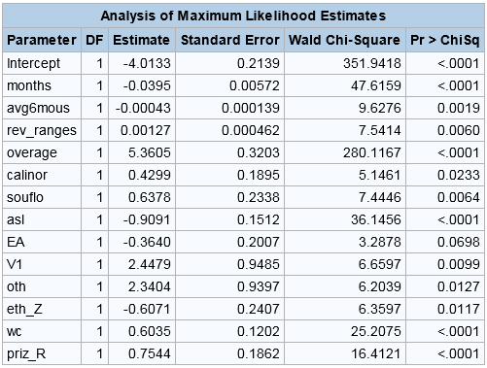
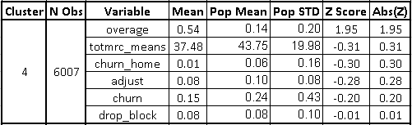
Cluster 4– Highest proportion of Overage in revenue

Slide 27
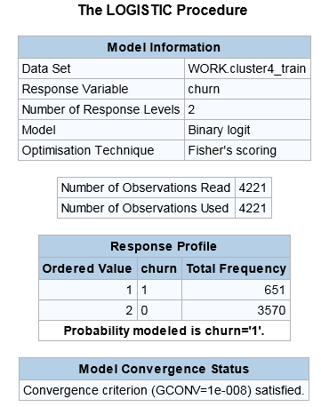
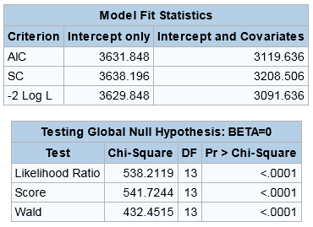
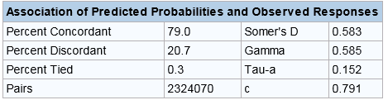
C4_Train Goodness of Fit
Accuracy
= (49+3495)/(49+3495+75+602)
= 84%
 | Predicted Non-Events (0) | Predicted Events (1)
Actual Non-Events (0) | True Negatives (3495) | False Positives (75)
Actual Events (1) | False Negatives (602) | True Positives (49)

Slide 28
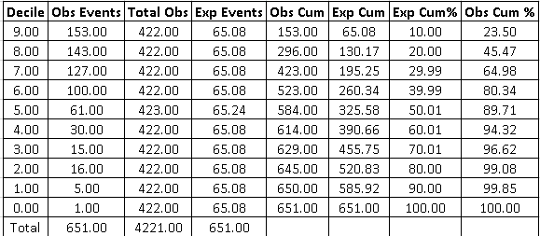

Slide 29
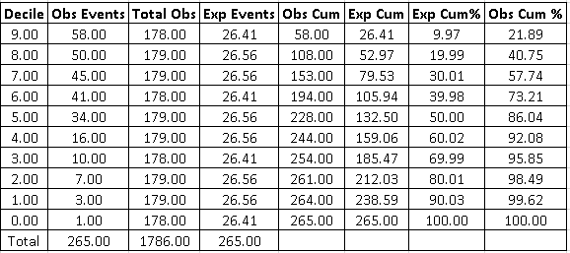

Slide 30
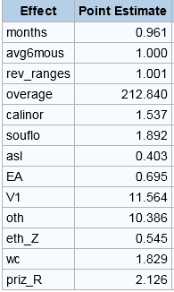
Factors affecting churn for Cluster4
The customers of this segment have on an average the highest proportion of overage in the bill
Top 5 factors affecting churn for this segment are:-
0.1 increase in overage will lead to (212^0.1=1.7) 70% increase in the odds of churn
Customers with credit rating V1 have 11 times the odds of churn as compared to AA
Customers with credit rating in others (low freq credit ratings) have 10 times the odds of churn as compared to AA
Those who have web capable mobiles have 80% higher odds of churn as compared to those who have a web capable mini browser handset.
If asl flag is 1 then there are 60% lesser odds of churn as compared to asl being 0
If customer belongs to rural area then the odds of churn are 2 times as compared to him belonging to suburban area

Slide 31
Strategy to move customers to an optimal plan to minimize overage and hence churn
In this segment of customers who have high proportion of overage in the bill we should target those first who have a high chance of switching.
Those who have a credit rating of V1 or others
Those who have a web capable handset without mini browser
Customers belonging to rural areas
Customers from South Florida and North California

Slide 32
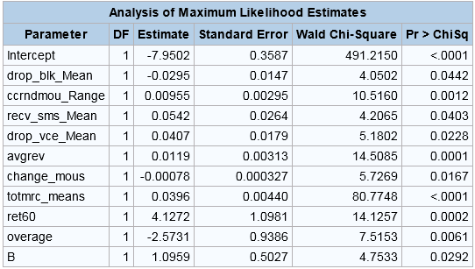
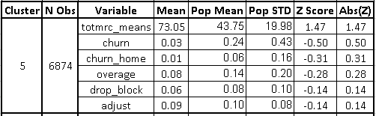
Cluster 5 – High Monthly Recurring Amount

Slide 33
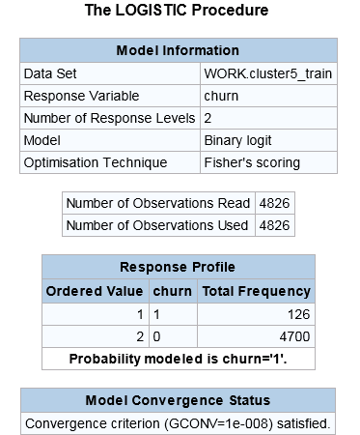
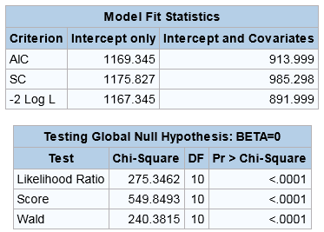
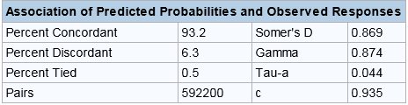
C5_Train Goodness of Fit
Accuracy
= (7+4677)/(7+4677+23+119)
= 97%
 | Predicted Non-Events (0) | Predicted Events (1)
Actual Non-Events (0) | True Negatives (4677) | False Positives (23)
Actual Events (1) | False Negatives (119) | True Positives (7)

Slide 34
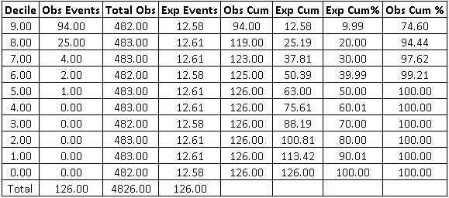

Slide 35
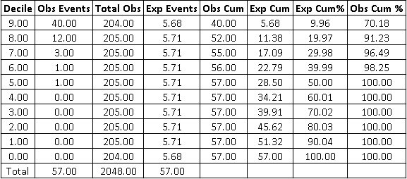

Slide 36
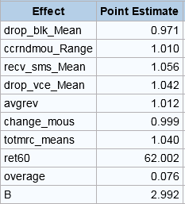
Factors affecting churn of Cluster 5
This segment has customers with maximum monthly recurring amount or in other words high usage
If the retention call has been made in the last 45-60 days then odds of churn increase by 60 times as compared to the call being made greater than 60 days ago
The customers who have credit rating as B have 3 times the odds of churn as compared to those with AA
0.1 increase in overage will lead to (0.076^0.1=0.77) 23% decrease in the odds of churn
Unit increase in mean of received sms will increase the odds of churn by 5%
Unit increase in mean of dropped voice calls will increase the odds of churn by 4%

Slide 37
Strategy to retain high usage customers
To prioritize the high usage customers and in an effort to retain them the company must focus on the following customers
Those customers who have received retention calls in the last 45-60 days must be prioritized
Customers in this segment having a credit rating B must be targeted
Customers having high number of SMS received
Customers facing a issue with dropped voice calls must be targeted
Any further increase in billing amount can lead to churn as they are already very high revenue generating customers

Slide 38
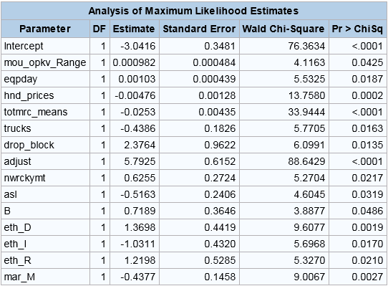
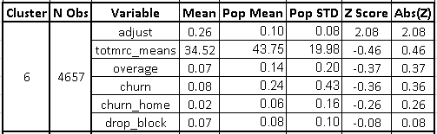
Cluster 6 High proportion of Adjusted amount in the bill and lowest monthly usage

Slide 39
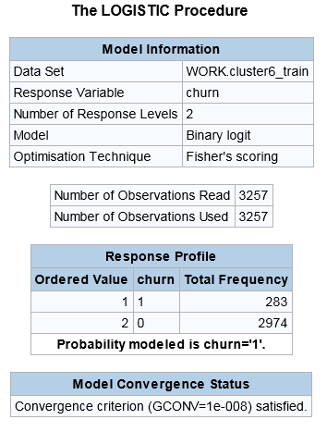
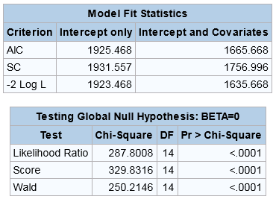

C6_Train Goodness of Fit
Accuracy
= (12+2945)/(12+2945+29+271)
= 91%
 | Predicted Non-Events (0) | Predicted Events (1)
Actual Non-Events (0) | True Negatives (2945) | False Positives (29)
Actual Events (1) | False Negatives (271) | True Positives (12)

Slide 40


Slide 41


Slide 42

Factors affecting churn for Cluster6
Customers of this segment are those whose proportion of adjusted amount in the bill is the largest.
Top 5 factors for churn are :-
South Europeans(D) and Arabs (R) have 3 times the odds of switching as compared to North European(N).
Customers with a credit rating of B are twice as likely to switch as compared to those having a rating AA
Italians have 65% less odds of switching as compared to North European(N)
0.1 increase in adjust leads to an increase of (328^0.1=1.78) 78%in the odds of switching. ((totrev-adjrev)/totrev)
0.1 increase in drop_block leads to an increase of (10^0.1=1.25) 25%in the odds of switching. (drop_block = drop_blk_mean*months/totcalls)

Slide 43
Retention strategy for high adjusted amount and low usage customers
Introducing international calls/roaming plans for South Europeans(D) and Arabs (R)
Customers belonging to New Rocky Mountain area must be prioritized and should be given retention calls along with special plans customized for their needs
Customers having credit rating B must be prioritized
Customers facing issues of dropped and blocked calls must be focused and should be provided with optimal solutions

Slide 44
Conclusion
We have seen top 5 factors across all the segments and leading to the churn and most common of them are (Other than regional and ethinic factors)
High number of dropped and blocked calls
High overage charges
High adjust amounts
Recommendation of family
Low usage
We have also set different strategy for each segment and prioritized the customer base most likely to switch the operator, protect our high value customers and increasing the ARPU across the customer base.

Slide 45
Thank You and Have a Nice Day!!!!

